Slide 1
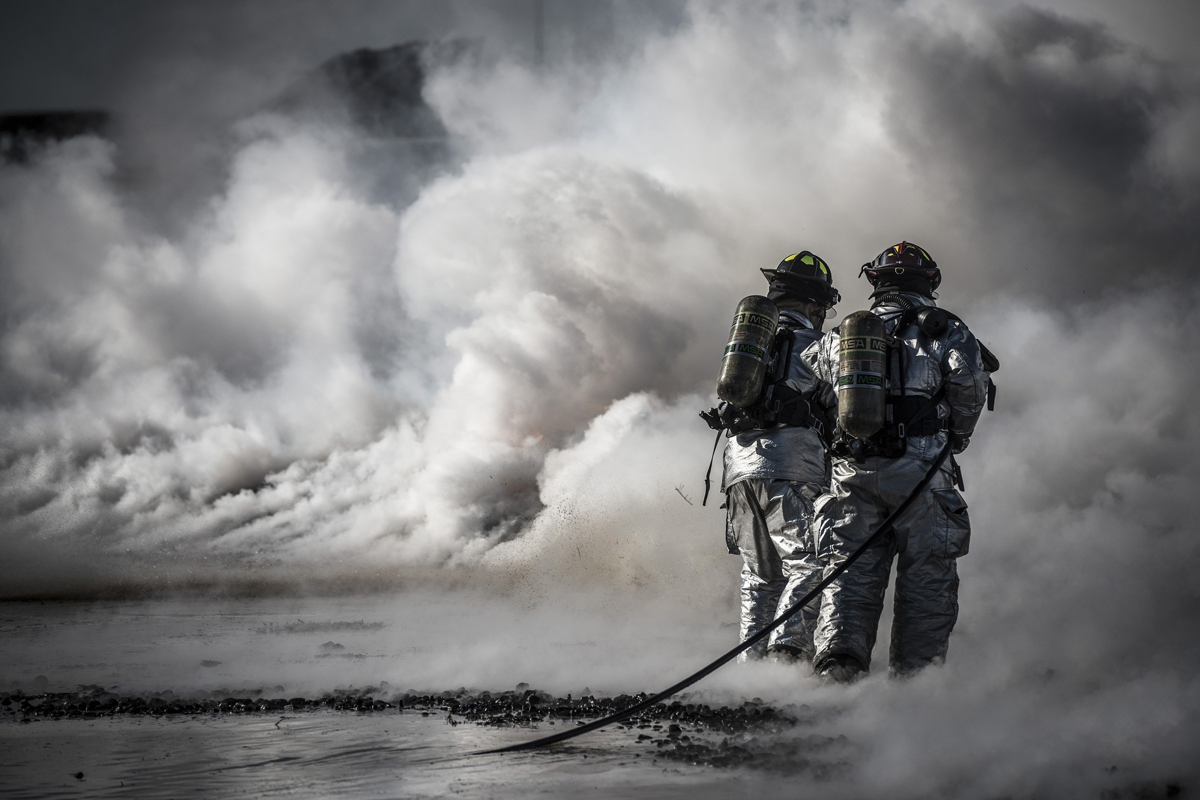
FULLY AUTONOMOUS
FIRE FIGHTING ROBOT
A project by
Sri Sai Ravi Charan Siddabathuni
Raahul M
Sena Abhishek
Sanjay Krishnaa

Slide 2
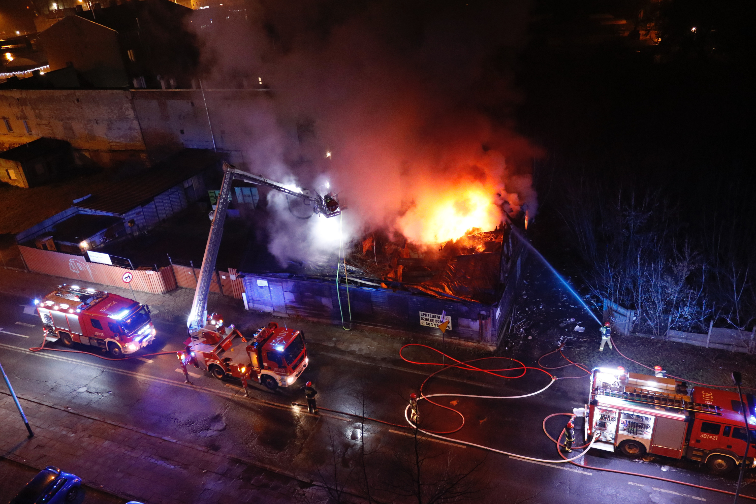
AGENDA
01
02
03
04
Introduction
Novelty
Components required
Budget
05
06
07
08
Objectives
Challenges Faced
Implementation
Proposed Timeline

Slide 3
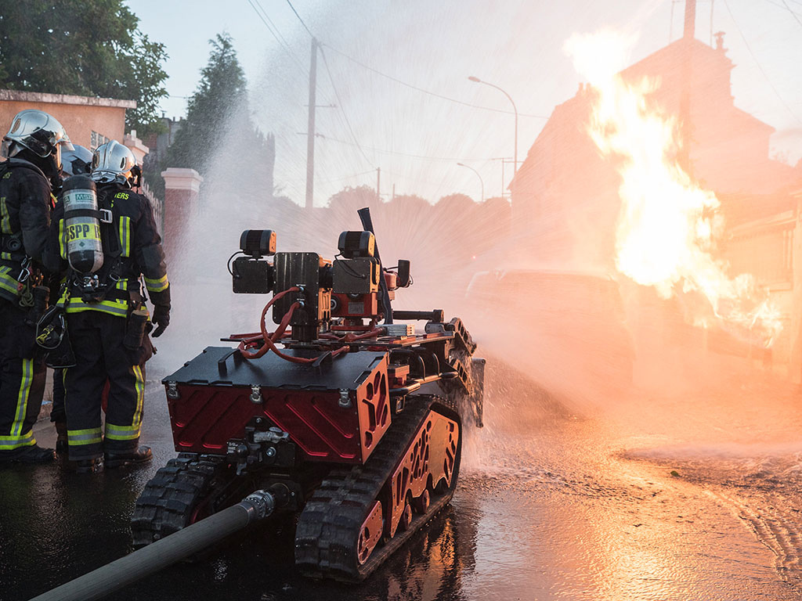



INTRODUCTION
In the ever-evolving domains of architecture and technology, the advent of intricate emergency scenarios necessitates the development of groundbreaking solutions. Ushering in a revolutionary epoch in emergency response protocols, an advanced robotic system is primed to transform firefighting methods within treacherous environments. Equipped with state-of-the-art fire suppression mechanisms, advanced therma﻿l imaging capabilities, and a comprehensive array of sensors, this robotic ally emerges as an indispensable asset when faced with intense heat, thick smoke, and precarious situations .

Slide 4
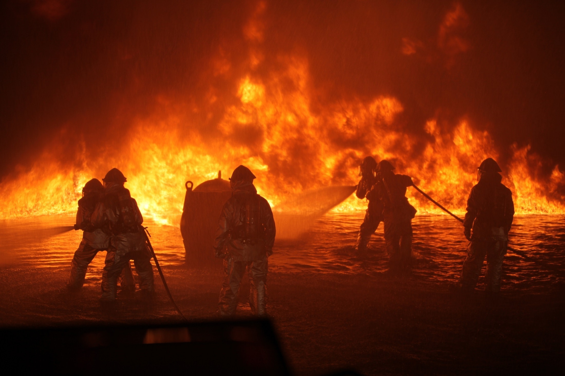
01
Exhibiting exceptional adaptability and durability, the robot adeptly manoeuvres through confined spaces, tolerates scorching temperatures, and rapidly pinpoints individuals caught amidst danger. This pioneering robotic phenomenon transcends mere fire combat; its skill set encompasses managing hazardous materials, evaluating building stability, and remotely monitoring areas that are susceptible to combustion.
Collaborating seamlessly with human counterparts, the firefighting robot is poised to enhance efficiency, bolster safety measures, and elevate success rates during emergency operations—ultimately safeguarding the well-being of both firefighters and those they valiantly strive to defend.

Slide 5

NOVELTY
Thermite, created by Howe and Howe Technologies Inc, is a remote-controlled firefighting robot with a 400m operational range. It can deliver 1200 gpm of water or 150 psi of foam, measuring 187.96cm x 88.9cm x 139.7cm. Powered by a diesel engine producing 25 bhp (18.64 kW), its key features include a multi-directional nozzle and a pump delivering 600 gpm (2271.25 l/min). This robot is specifically designed for high-risk areas like plane fires, factories, and nuclear reactors.
When a fire incident occurs in a building like a hospital, the temperature of the surroundings rapidly escalates from 80 to 600 degrees within a short period of about 10 minutes.
There is a need for autonomous firefighting robots that can swiftly extinguish fires and minimize risks to patients, staff and valuable medical equipment, ensuring safety and preventing potential damage.
A DC motor can withstand temperatures ranging from 125 to 160 degrees. There is a need for thermal insulation.
The commercialization of a compact, lightweight, and cost-effective autonomous firefighting robot aims to make it accessible to the general public. This innovative solution empowers individuals to enhance fire safety measures and affordability. More people can proactively protect their homes, businesses, and communities, mitigating fire risks and ensuring a safer environment for all.
The robot is equipped with a stereo IR camera [thermal imaging] for 3D depth sensing and an FMCW-based radar sensor to detect the distance of the objects. This robot will also have thermophile infrared Array sensors to locate humans and priortize.
FASTNESS
COMMERCIALISATION
Sensors

Slide 6

NOVELTY
In the previous application there is no provision for multiple robots to work collectively. Here we use modern communication systems when connects each robot to a system and this will help the fire fighting robots to work as a team and divide the number of robots needed according to intensity of fire and area . This will be done using AI integration.
INTERCOMMUNICATION

Slide 7


Proposed Budget
Components | Value | Amount in Total
UNO arduino | ₹600 | 1 X 600 = 600
Flame sensor | ₹55 | 4 X 55 = 220
DC motor | ₹93 | 4 X 93 = 372
DC submersible Pump | ₹95 | 1 X 95 = 95
Motor driver | ₹150 | 1 X 150 = 150
Single channel Relay Module | ₹60 | 1 X 60 = 60
Robo car model | ₹800 | 1 X 800 = 800
TOTAL |  | 2300

Slide 8
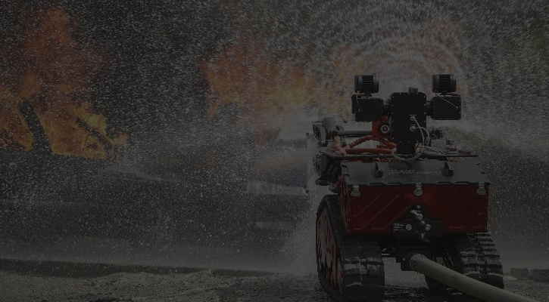
OBJECTIVE
Rapid response and 24/7 availability
Efficient fire suppression
Enhanced safety
Fire incidents pose significant risks to human firefighters. By deploying an automatic fire extinguisher robot, we can reduce the need for human intervention in dangerous environments. The robot can navigate through hazardous areas, minimizing the exposure of firefighters to flames, smoke, and toxic gases.
Fire incidents can occur at any time, including when emergency response teams might be delayed or unavailable. An automatic fire extinguisher robot can be programmed to respond swiftly, detecting fires and initiating extinguishing procedures immediately. This ensures round-the-clock availability and a rapid response, potentially minimizing the spread of fires and reducing property damage.
Fire extinguisher robots can be designed to navigate autonomously or remotely controlled. They can accurately assess the fire's location and use various sensors to detect heat, smoke, or flames. With this information, the robot can navigate to the source of the fire and apply the appropriate extinguishing agents precisely and efficiently, improving fire suppression effectiveness.

Slide 9
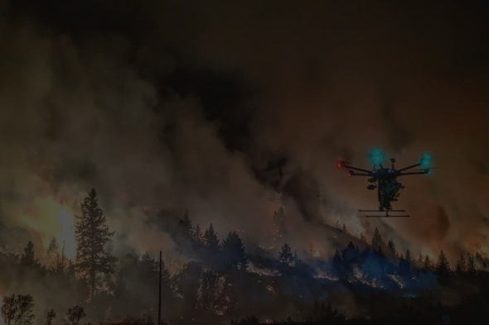
OBJECTIVES
Access to confined spaces
Continuous monitoring and data collection
Collaborative firefighting
Fast Rescuing
Some fires occur in locations that are challenging for humans to access, such as tight corridors, crawl spaces, or high-rise buildings. Fire extinguisher robots can be built with compact and agile designs, allowing them to maneuver through confined spaces that might be difficult or dangerous for humans. This capability enables better reach and more effective fire suppression in hard-to-reach areas.
Fire extinguisher robots can be equipped with sensors to monitor fire conditions and collect real-time data. This information can be invaluable for firefighters and emergency management teams, providing insights into fire behavior, temperature patterns, and other critical data. Analyzing this data can help improve firefighting strategies, enhance safety protocols, and contribute to future fire prevention efforts.
Fire extinguisher robots can be designed to navigate autonomously or remotely controlled. They can accurately assess the fire's location and use various sensors to detect heat, smoke, or flames. With this information, the robot can navigate to the source of the fire and apply the appropriate extinguishing agents precisely and efficiently, improving fire suppression effectiveness.
Fire extinguisher robot can be deployed with Sensor to locate humans caught in fire and provides for importance for evacuating first.
Overall, an automatic fire extinguisher robot has the potential to revolutionize firefighting by providing a safer, faster, and more efficient approach to fire suppression. By reducing human exposure to danger, offering continuous monitoring, and enabling access to hard-to-reach areas, these robots can significantly benefit the current firefighting and emergency response situations in the real world.

Slide 10

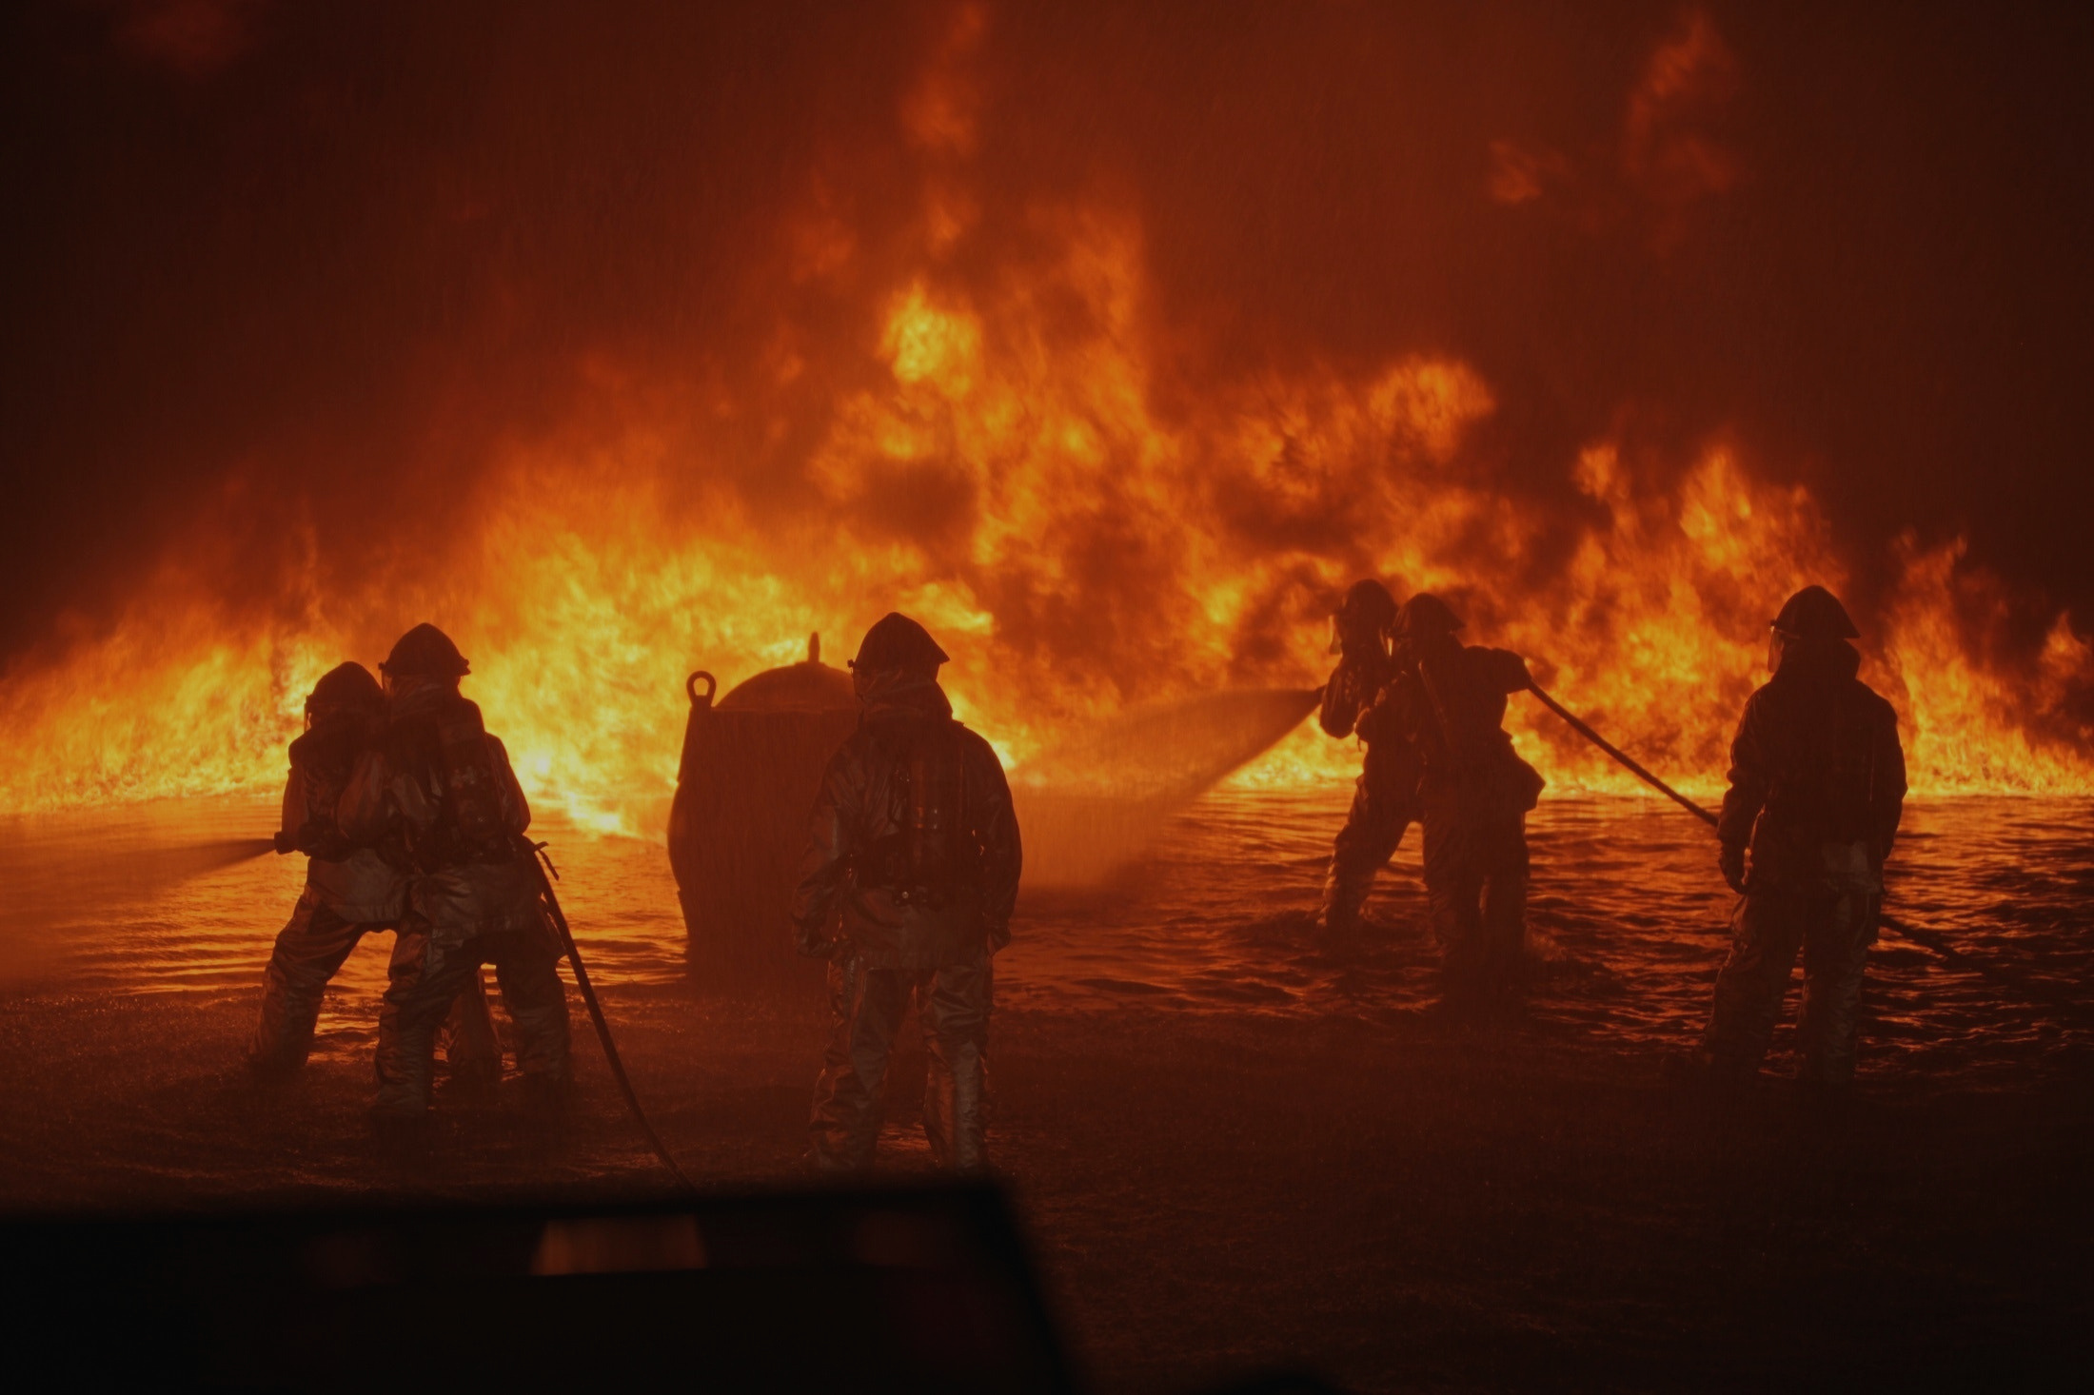
CHALLENGES
FACED

Slide 11
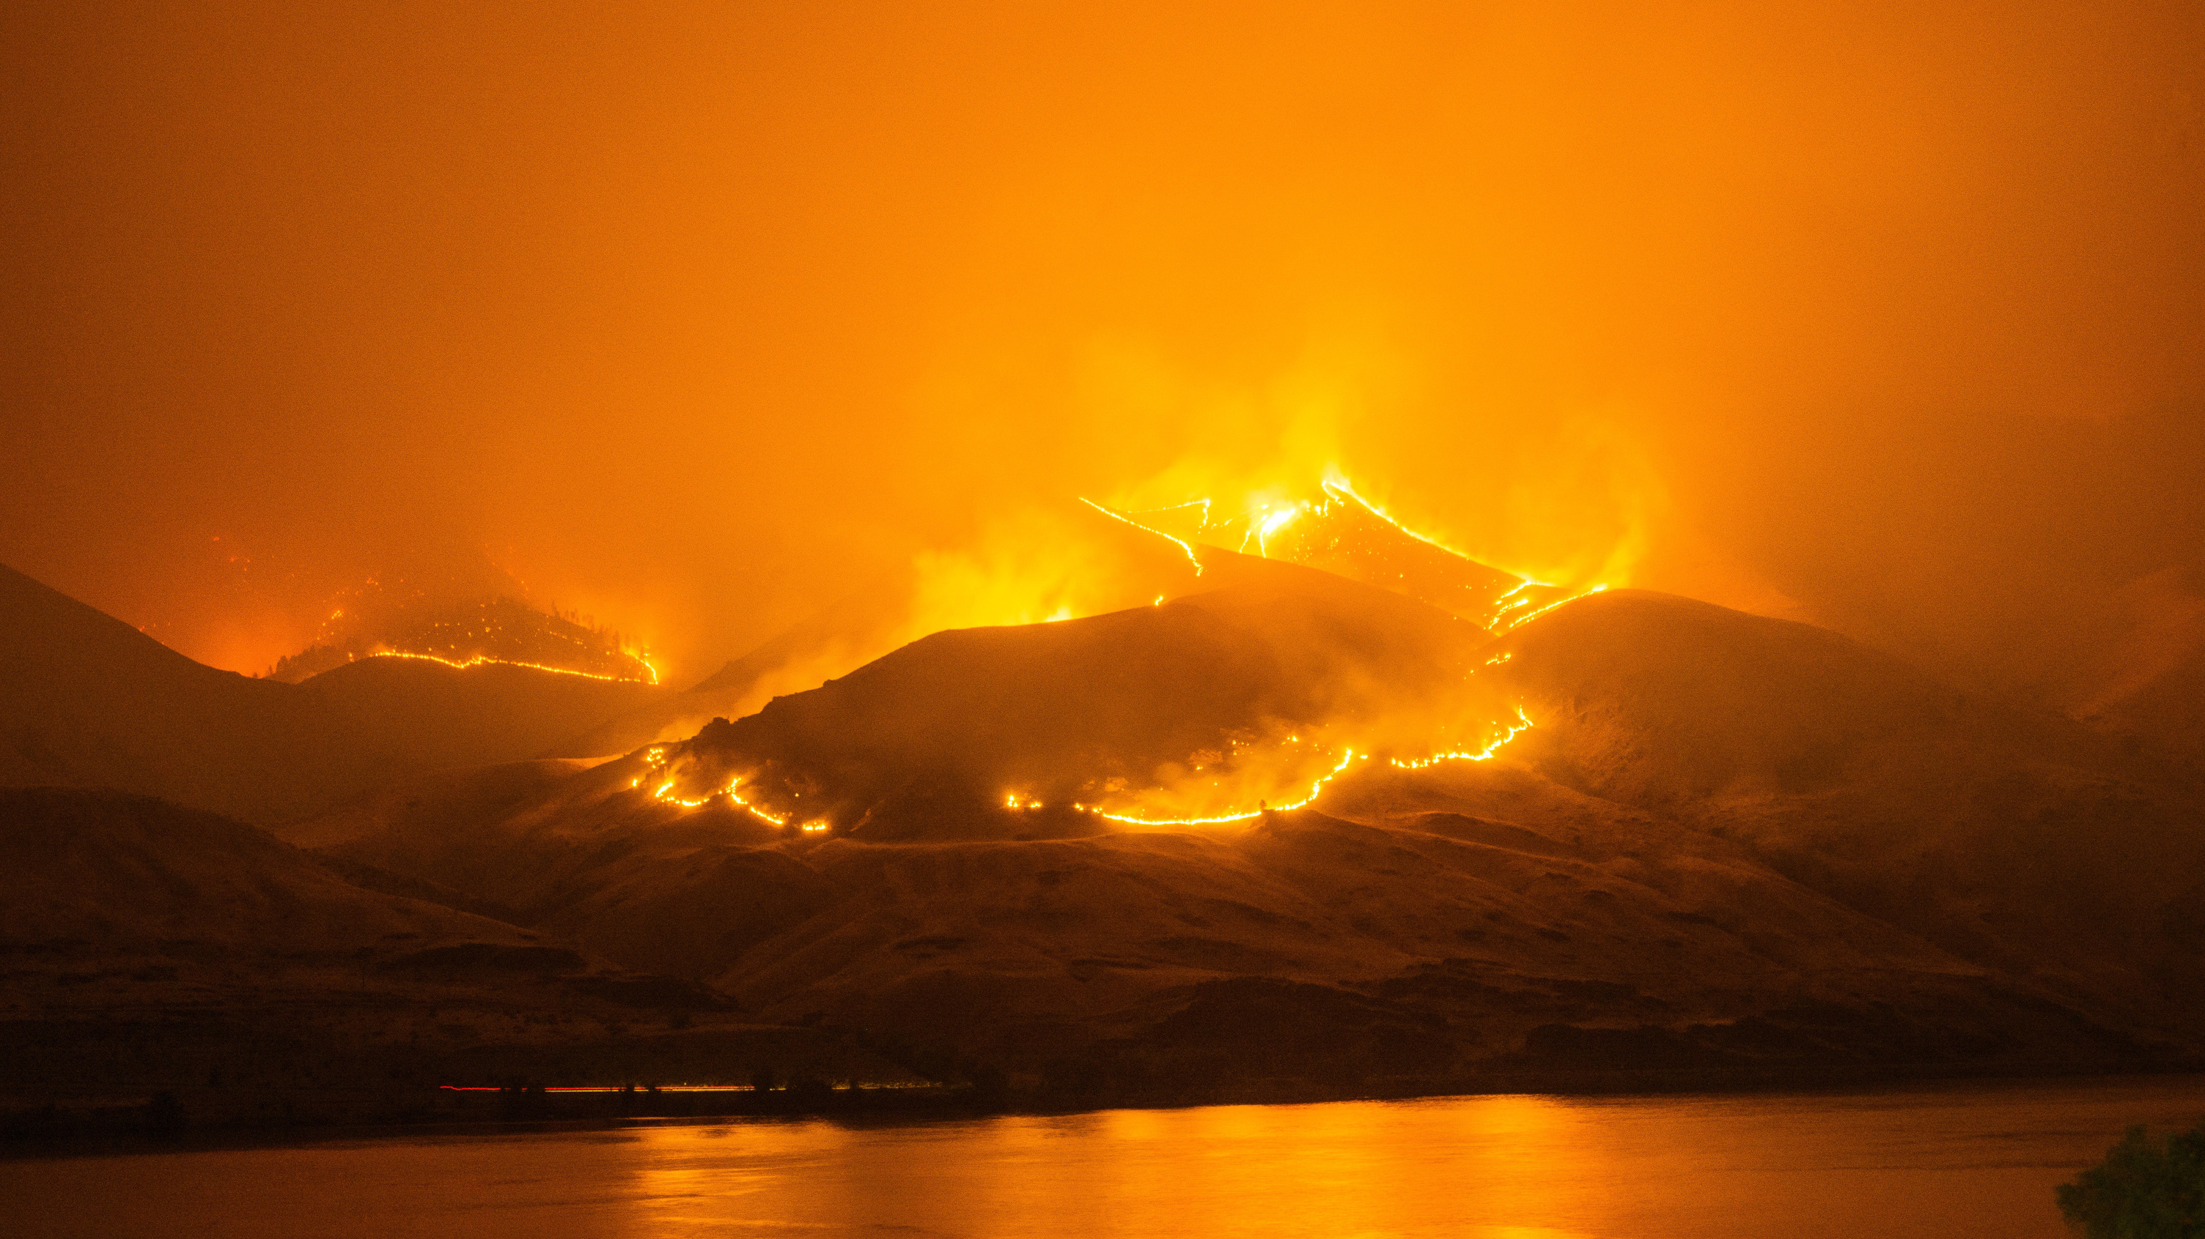

Limited adaptability
Navigation challenges
Limited sensory perception
Temperature Resistance
The firefighting robots may encounter dynamic fire scenarios characterized by variations in intensity, heat sources, fuel types, and environmental conditions where they might face difficulties in identifying and responding effectively.
Apart from navigating through obstacles, debris, and changing environments, smoke, poor visibility, and structural damage can hinder their movement and decision-making capabilities.
They might not have the ability to perceive and interpret fire-related cues accurately, such as changes in temperature, heat radiation, or toxic gasses, which human firefighters can sense.
Fire-resistant materials such as heat-resistant alloys or special coatings can be used to protect the robot's structure from damage or deformation caused by intense heat. Also, thermal insulation materials can help maintain a stable internal temperature, preventing overheating or damage to delicate electronics.
01
02
03
04

Slide 12
Cooling Systems
Fire suppression techniques
Payload capacity
Power and energy considerations
Incorporating cooling systems to prevent overheating of critical components. These can include heat sinks, fans, or liquid cooling mechanisms. This helps to maintain the robot's performance and prevent damage to its internal systems.
Firefighting encompasses various techniques like applying water, deploying foam, or utilizing fire extinguishing agents. Robots must possess the capability to execute these techniques precisely and proficiently, all while adapting to unique fire conditions and behavior.
They need to balance their weight and mobility. Carrying a large amount of water can significantly increase their weight, potentially limiting their maneuverability and overall performance. Also, they need to dispatch anytime responding to the request, so a compact size is preferred.
Water is heavy, and carrying a substantial amount of water requires additional power. The energy consumption for transporting and pumping water can impact the robot's battery life and operational endurance that rely on batteries or power sources.
05
06
07
08

Slide 13

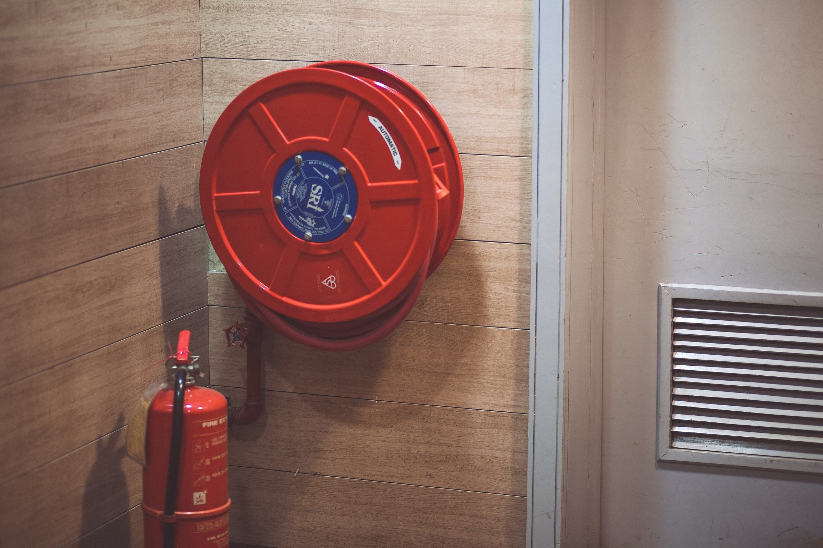
IMPLEMENTATION
The automatic fire fighter should be mobilised to be able to move towards the fire. The movement will be possible by wheels using DC motor to bring about the movement in the direction of the Fire as fast as it can.
The fire fighting system should be able to detect fires accurately
and efficiently. For this we use a flame sensor module to detect the fire. The output is then sent to the Arduino board.
we use a water container to store the water and a nozzle and pipe to spray the water using a submersible dc pump. we use a servo motor to adjust the direction of nozzle.
we use an arduino board to connect and control all these components and combine the data to move towards and put out fires efficiently

Slide 14
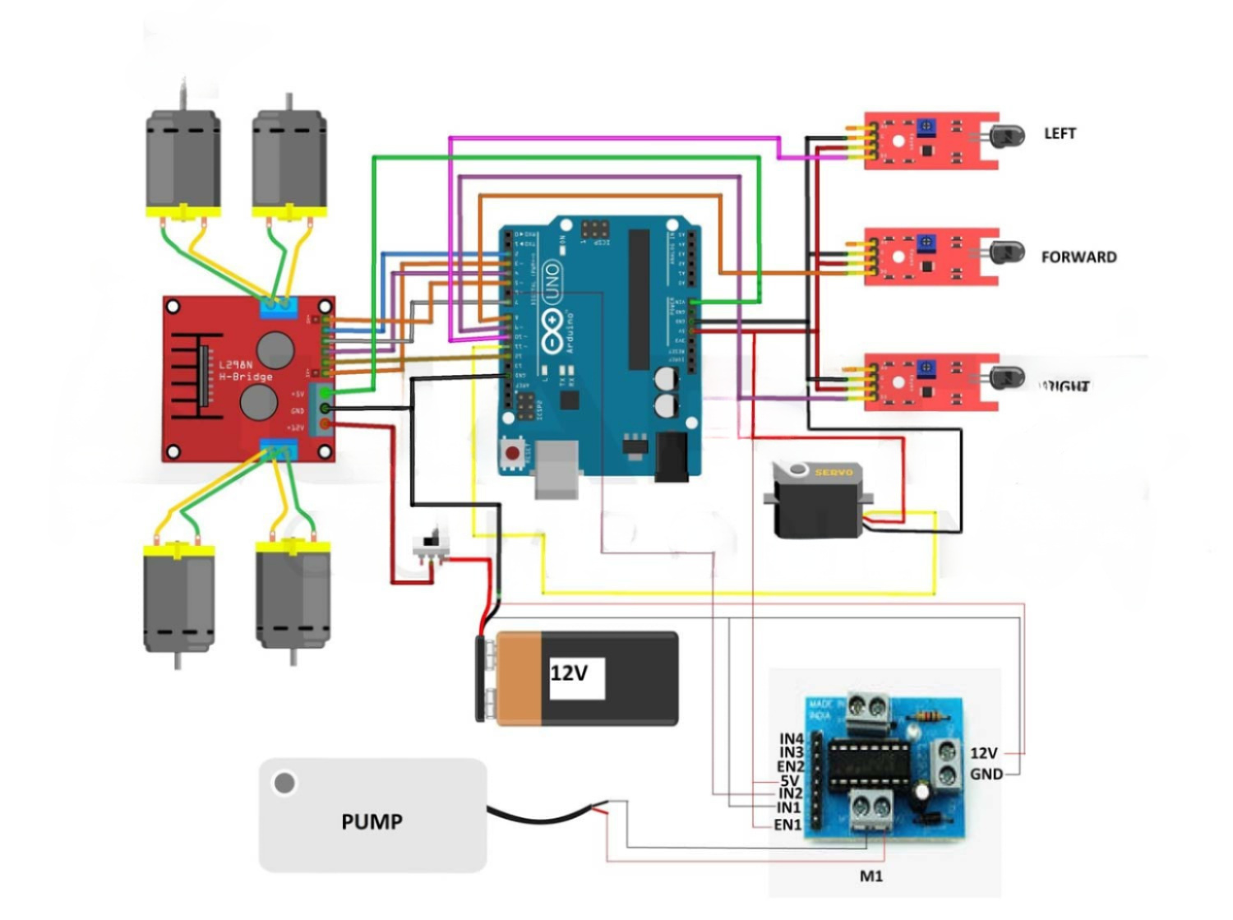
CIRCUIT DIAGRAM

Slide 15
Proposed Timeline
1 week
2 week
1 week
4 days
Developing an automatic fire-fighting robot involves several stages of planning, design, development, and testing. Here's a general timeline that can serve as a reference:
Research and Concept Development
Design,
Hardware Assembly and Integration
Software Development
Testing, Finalization and Documentation

